Slide 1
COVID-19 – LOCAL GROUP/ELEMENTS
Reminder Exchange Backup for Post-Installation

Slide 2
CREATE A REMINDER DIALOG GROUP Reminder Dialog Management > Reminder Dialogs

Slide 3
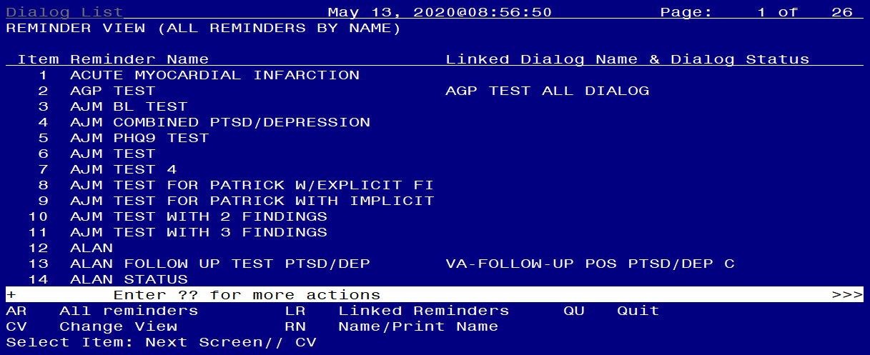
CREATE A REMINDER DIALOG GROUP Change View (CV)

Slide 4
CREATE A REMINDER DIALOG GROUP Group View (G)

Slide 5
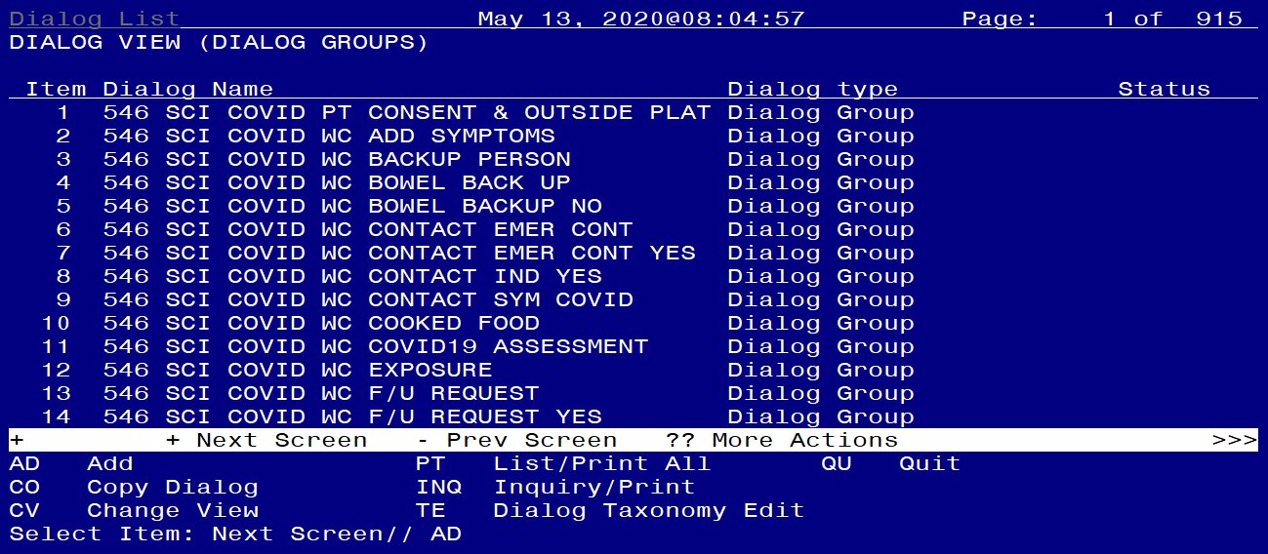
CREATE A REMINDER DIALOG GROUP Add a Group (AD)

Slide 6
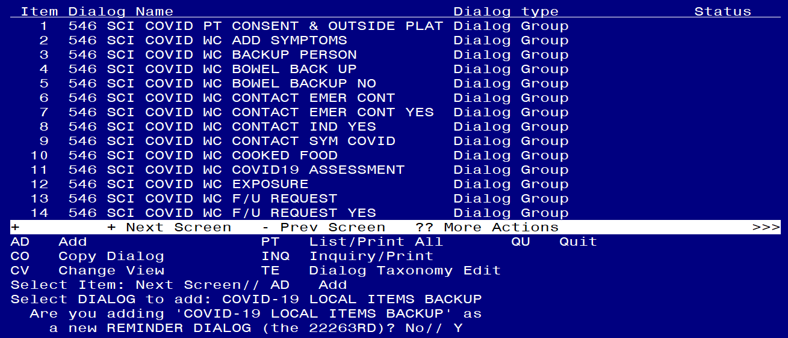
CREATE A REMINDER DIALOG GROUP Name the Group

Slide 7
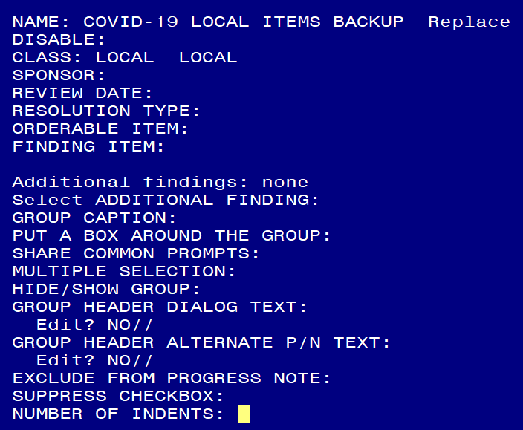
CREATE A REMINDER DIALOG GROUP Set CLASS to LOCAL

Slide 8
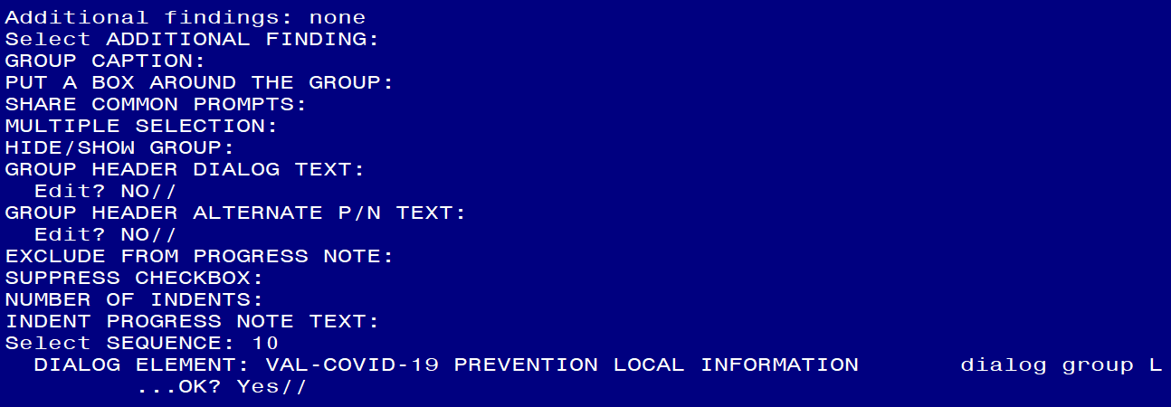
CREATE A REMINDER DIALOG GROUP Add Sequences for each Group and Element

Slide 9
CREATE A REMINDER DIALOG GROUP List of Groups and Elements to Add Sequences
Add the following reminder dialog GROUPS:
VAL-COVID-19 PREVENTION LOCAL INFORMATION
VAL-COVID-19 POSITIVE LOCAL INFORMATION
VAL-COVID 19 RESULTS NEGATIVE LOCAL INFORMATION
VAL-COVID-19 PENDING LOCAL INFORMATION
VAL-COVID PLAN REFERRAL
VAL-COVID PLAN TRANSFER
VAL-COVID PLAN ADMISSION
VAL-GP COVID ASSESSMENT COVID MILD
VAL-GP COVID ASSESSMENT ESC OF CARE F2F NON ED
VAL-GP COVID ASSESSMENT ESC OF CARE VIRTUAL
VA-GP COVID ASSESSMENT ESC OF CARE F2F NON ED URGENT
VA-GP COVID ASSESSMENT ESC OF CARE VIRTUAL URGENT
VAL-GP COVID-19 FOLLOW UP CALL
VAL-GP COVID-19 FOLLOW-UP PLAN EDUCATION
Add the following reminder dialog ELEMENTS:
VAL-COVID-19 FOLLOW-UP PLAN ED NURSE HOTLINE
VAL-COVID-19 FOLLOW-UP PLAN ANNIE
VAL-COVID-19 DIRECTIONS TO PACT
VAL-TH VVC TELEPHONE TRIAGE CONTACT PHONE OBJECT
VAL-COVID PATIENT INFORMATION
VAL-TH VVC TELEPHONE TRIAGE PATIENT LOCATION HOME
VAL-COVID ALLERGY AND MEDICATIONS
VAL-COVID FOCUSED EXAM TEMP
VAL-COVID PLAN DISCHARGE HOME FOLLOW UP

Slide 10
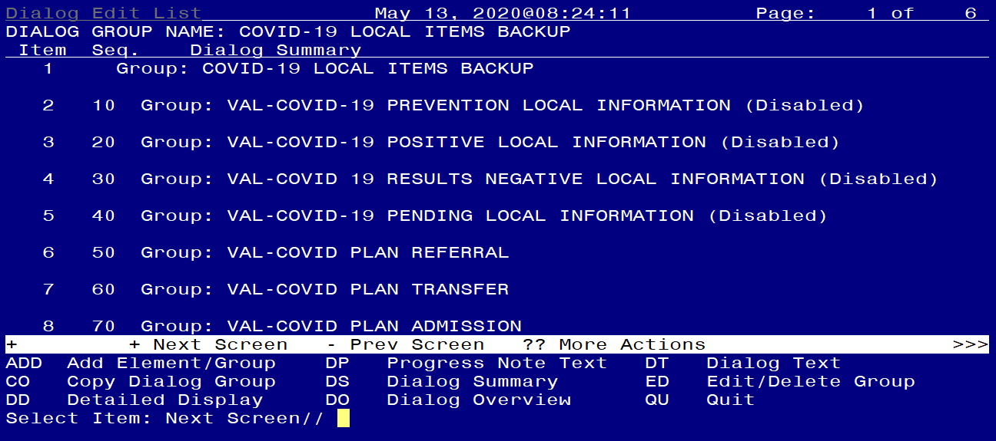
CREATE A REMINDER DIALOG GROUP Preview of the newly created Dialog Group

Slide 11
CREATE A REMINDER EXCHANGE ENTRY Enter the Reminder Exchange Menu

Slide 12
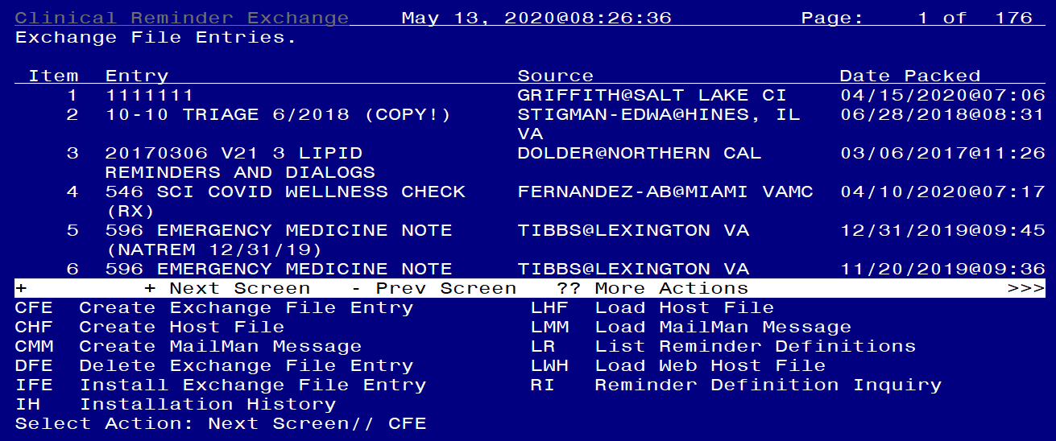
CREATE A REMINDER EXCHANGE ENTRY Select Create Exchange File Entry (CFE)

Slide 13
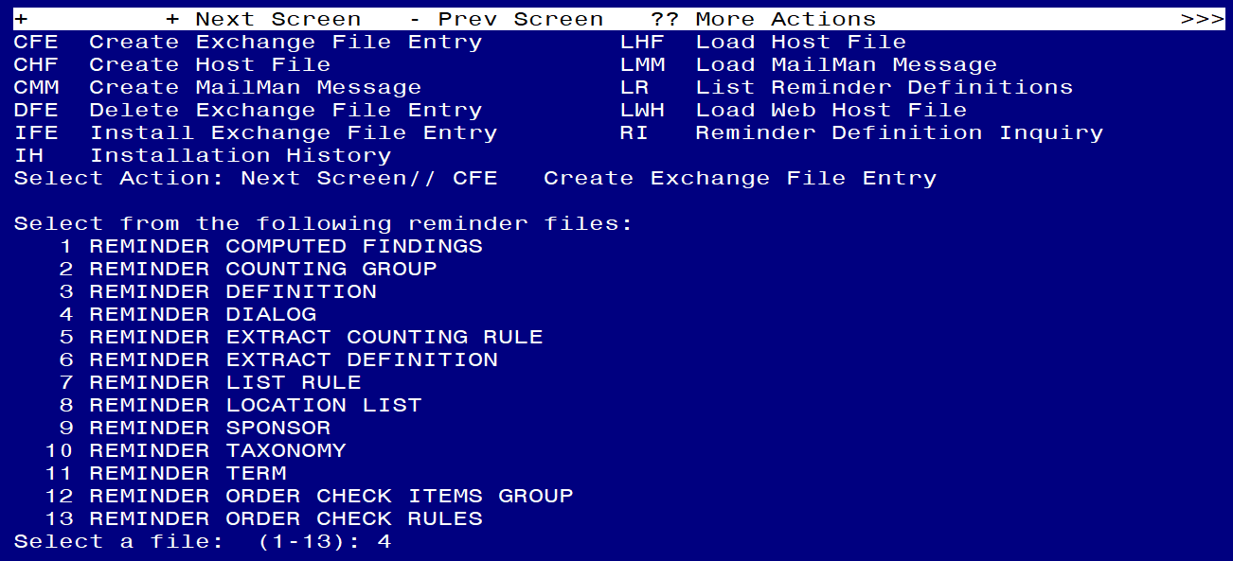
CREATE A REMINDER EXCHANGE ENTRY Select Reminder Dialog (Option 4)

Slide 14
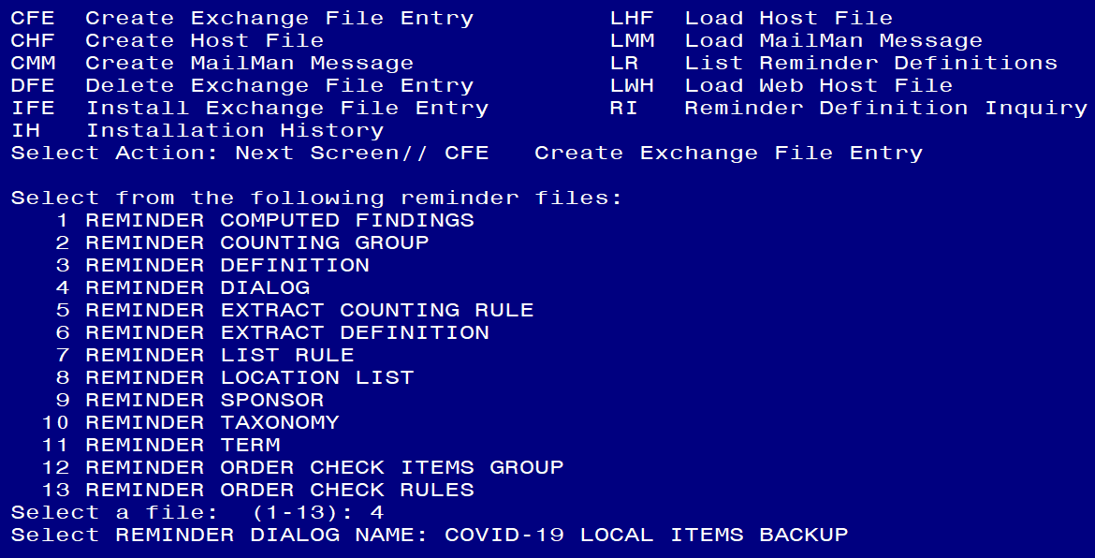
CREATE A REMINDER EXCHANGE ENTRY ENTER the dialog group name you created

Slide 15
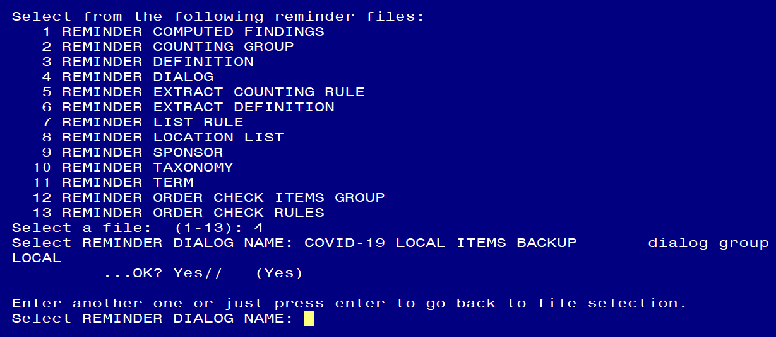
CREATE A REMINDER EXCHANGE ENTRY Select ENTER here

Slide 16
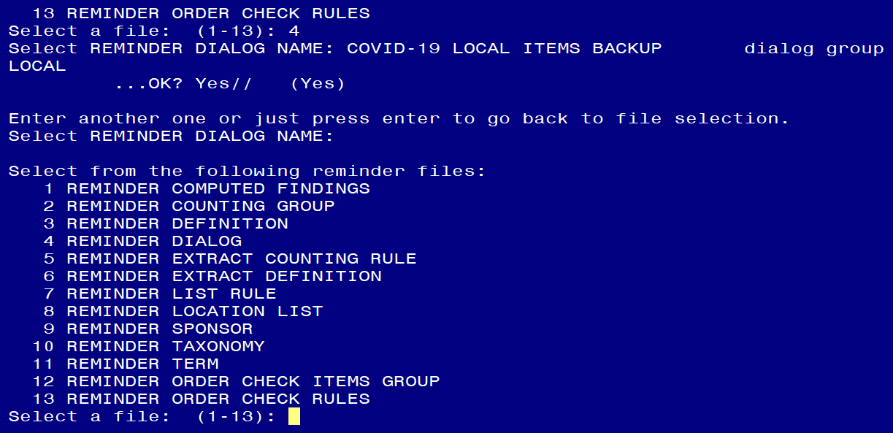
CREATE A REMINDER EXCHANGE ENTRY Select ENTER here

Slide 17
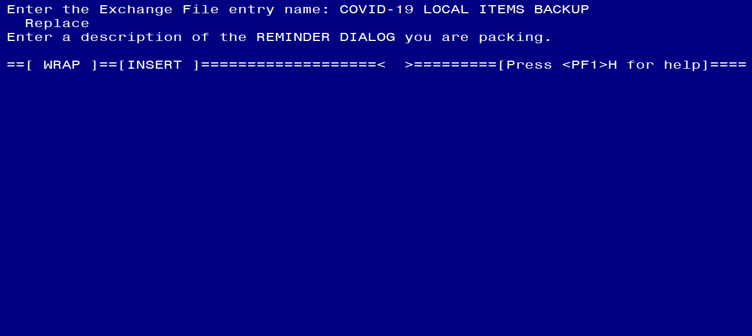
CREATE A REMINDER EXCHANGE ENTRY Enter the Exchange File Entry Name. Description is Optional. Then press F1E.

Slide 18
CREATE A REMINDER EXCHANGE ENTRY Press F1E again

Slide 19
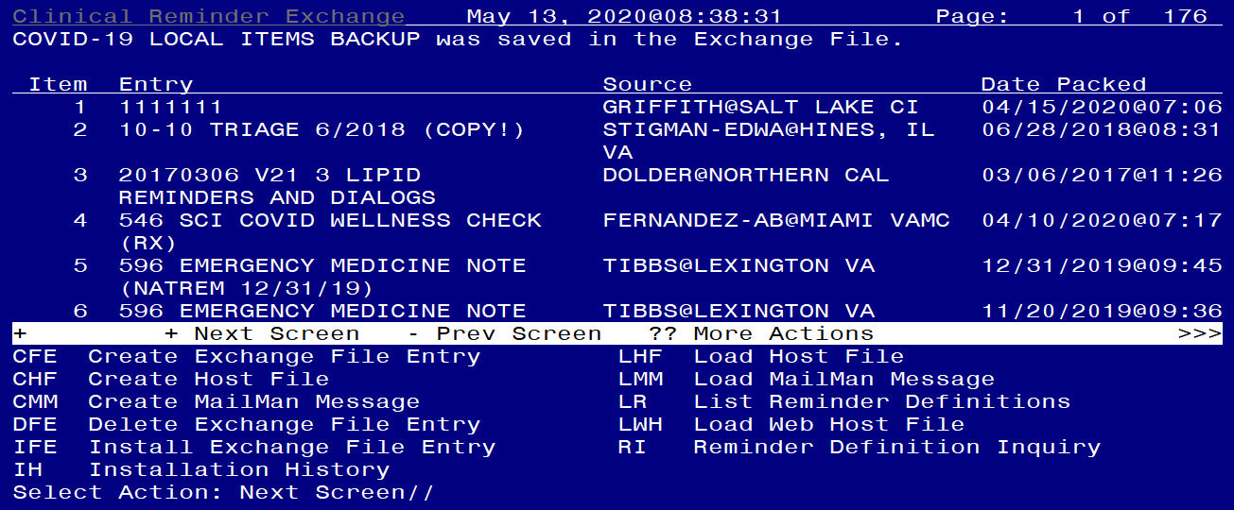
CREATE A REMINDER EXCHANGE ENTRY Finished. Exchange File has been created

Slide 20
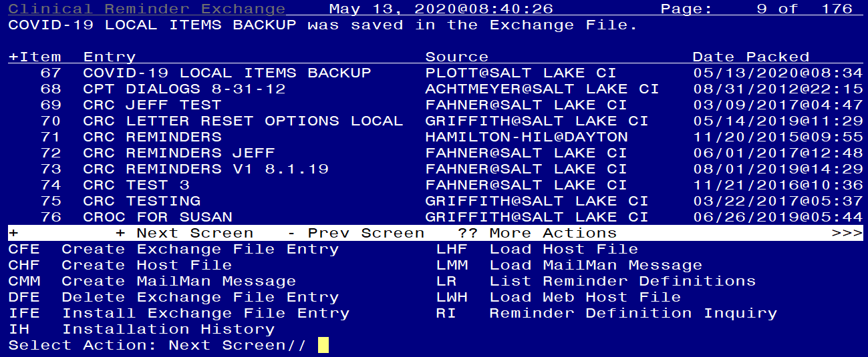
CREATE A REMINDER EXCHANGE ENTRY Confirm Exchange File is available

