Slide 1
COVID-19 – BACKUP GROUPS
Reminder Exchange Backup for Post-Installation

Slide 2
CREATE A REMINDER DIALOG GROUP Reminder Dialog Management > Reminder Dialogs

Slide 3
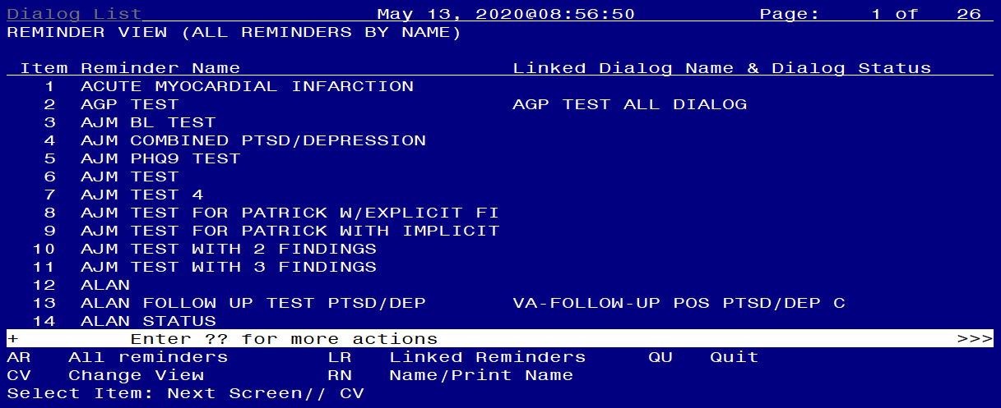
CREATE A REMINDER DIALOG GROUP Change View (CV)

Slide 4
CREATE A REMINDER DIALOG GROUP Group View (G)

Slide 5
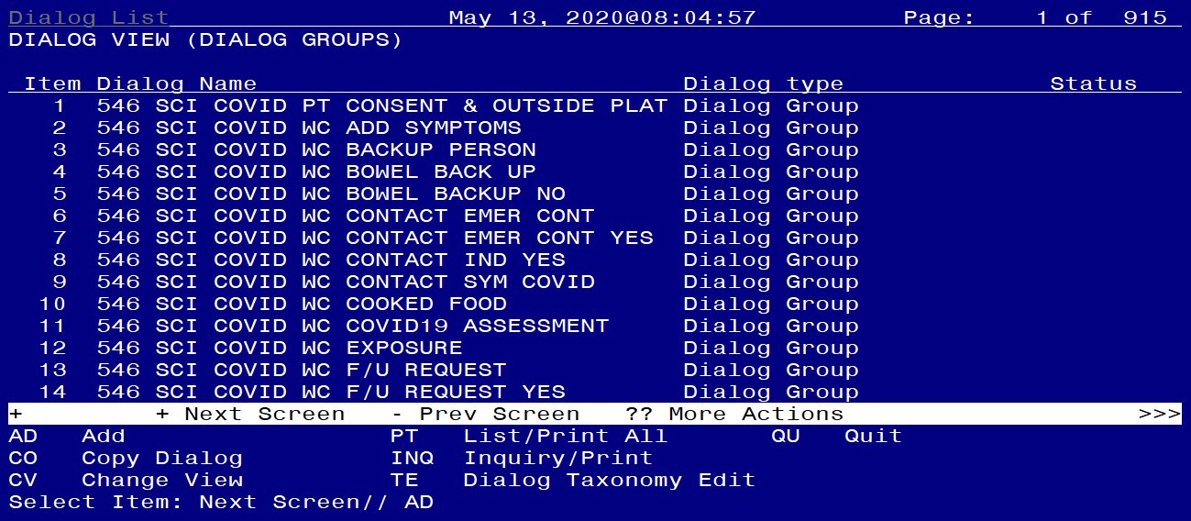
CREATE A REMINDER DIALOG GROUP Add a Group (AD)

Slide 6
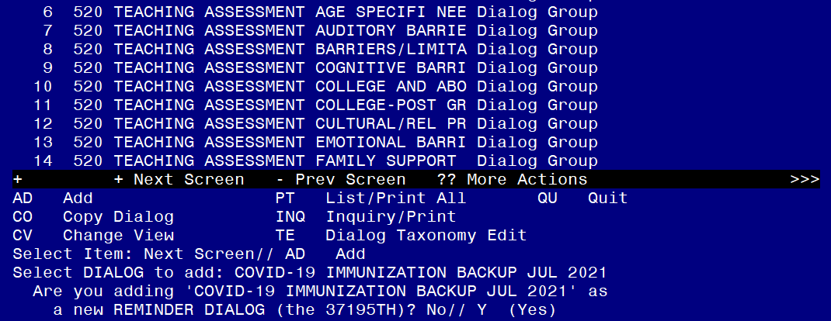
CREATE A REMINDER DIALOG GROUP Name the Group

Slide 7
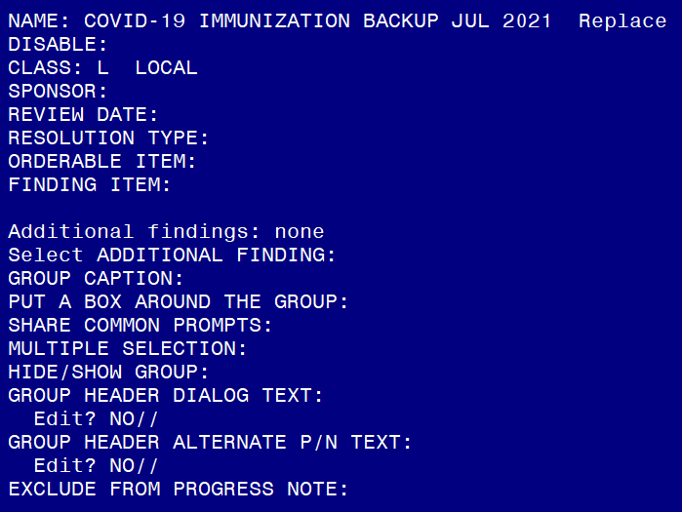
CREATE A REMINDER DIALOG GROUP Set CLASS to LOCAL

Slide 8
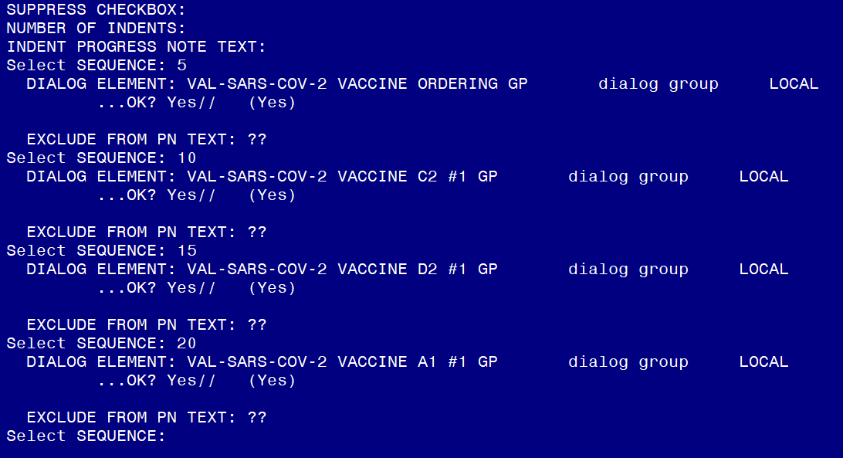
CREATE A REMINDER DIALOG GROUP Add Sequences for each of the 4 Groups

Slide 9
CREATE A REMINDER DIALOG GROUP List of Reminder Dialog Groups to Add Sequences
Add the following reminder dialog GROUPS:
VAL-SARS-COV-2 VACCINE ORDERING GP
VAL-SARS-COV-2 VACCINE C2 #1 GP
VAL-SARS-COV-2 VACCINE D2 #1 GP
VAL-SARS-COV-2 VACCINE A1 #1 GP

Slide 10
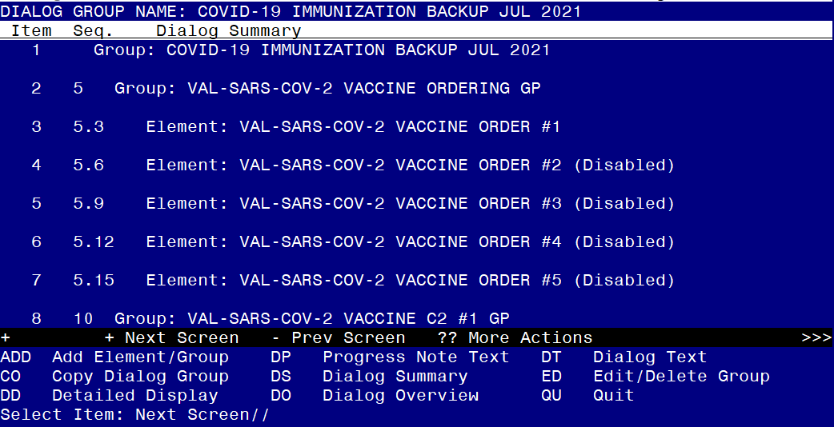
CREATE A REMINDER DIALOG GROUP Preview of the newly created Dialog Group
If your site has enabled those elements, they will not show as disabled

Slide 11
CREATE A REMINDER EXCHANGE ENTRY Enter the Reminder Exchange Menu

Slide 12
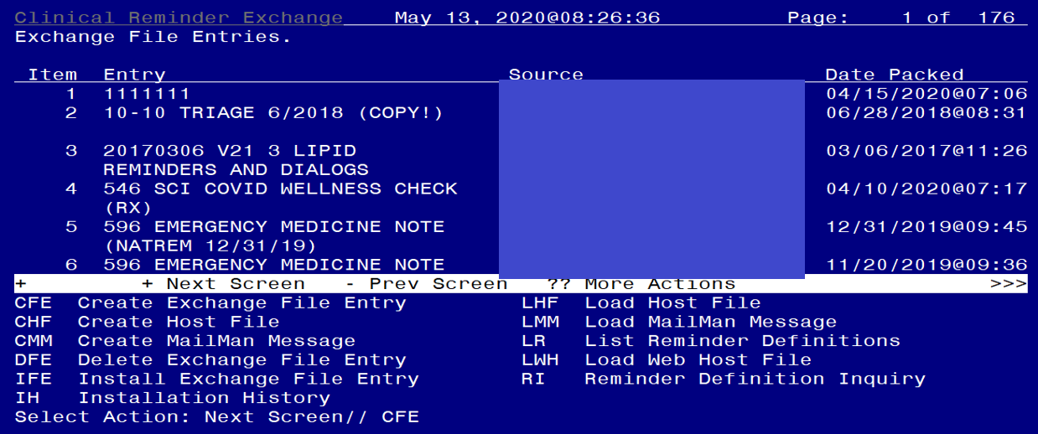
CREATE A REMINDER EXCHANGE ENTRY Select Create Exchange File Entry (CFE)

Slide 13
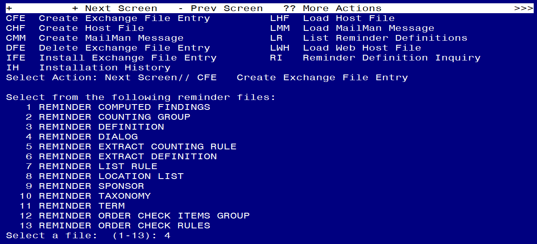
CREATE A REMINDER EXCHANGE ENTRY Select Reminder Dialog (Option 4)

Slide 14
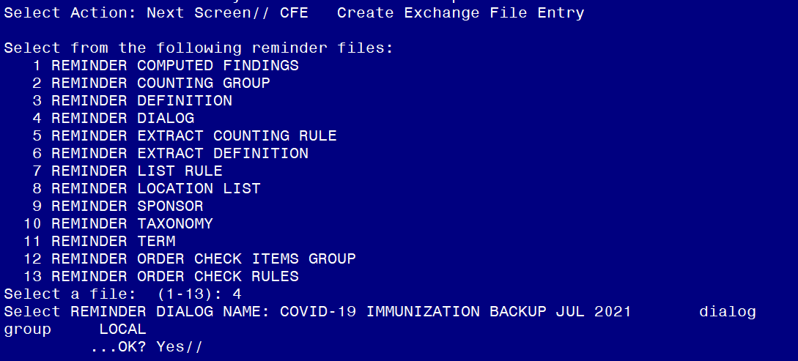
CREATE A REMINDER EXCHANGE ENTRY ENTER the dialog group name you created

Slide 15
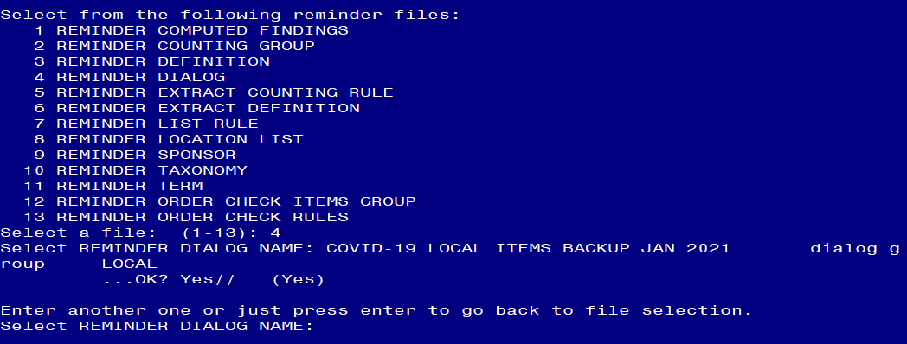
CREATE A REMINDER EXCHANGE ENTRY Select ENTER here

Slide 16
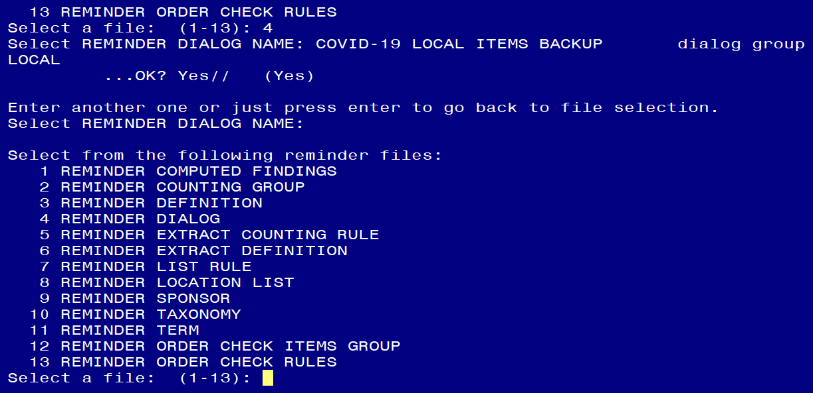
CREATE A REMINDER EXCHANGE ENTRY Select ENTER here

Slide 17
CREATE A REMINDER EXCHANGE ENTRY Enter the Exchange File Entry Name. Description is Optional. Then press F1E.

Slide 18
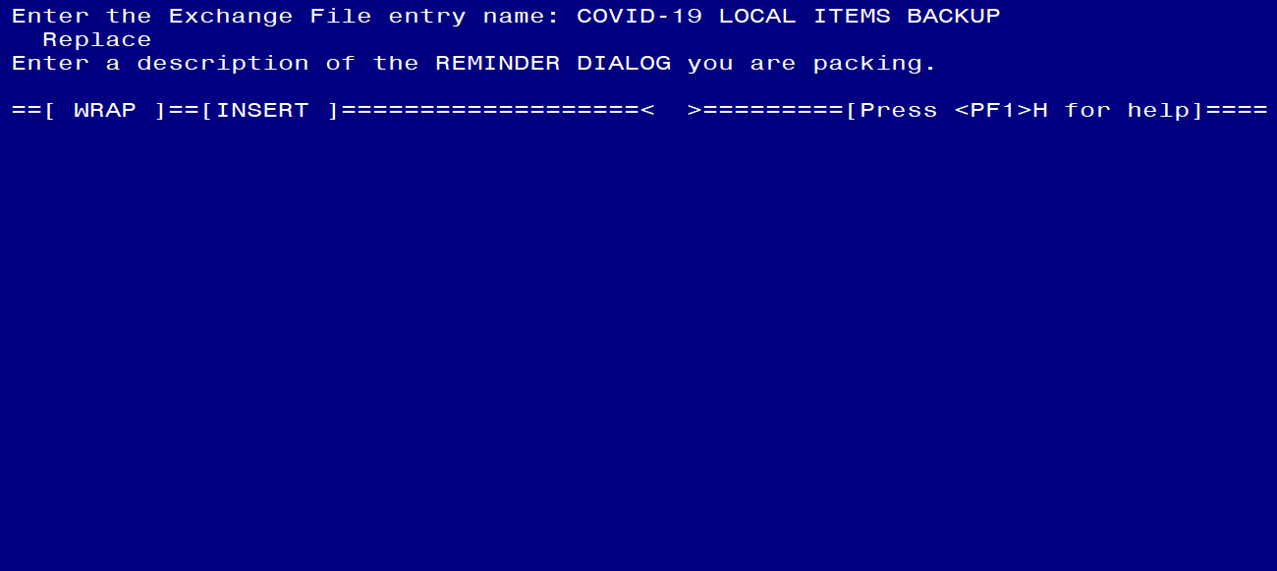
CREATE A REMINDER EXCHANGE ENTRY Press F1E again

Slide 19
CREATE A REMINDER EXCHANGE ENTRY Finished. Exchange File has been created

Slide 20
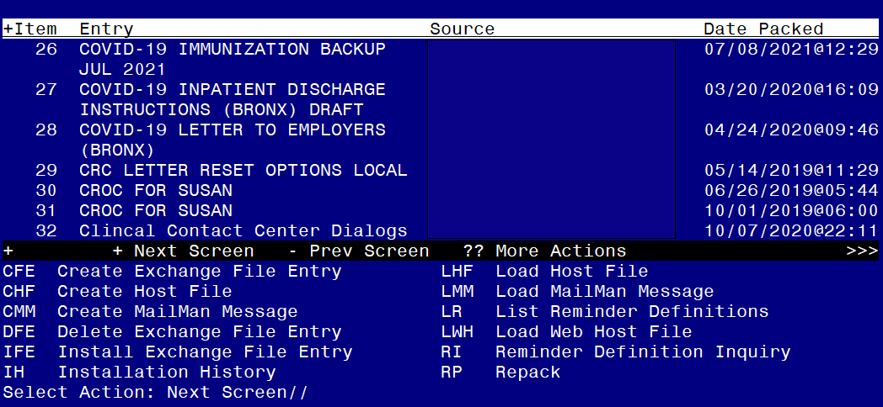
CREATE A REMINDER EXCHANGE ENTRY Confirm Exchange File is available

