Slide 1
Talk Title Slide VA Maternity Care Coordination

Slide 2
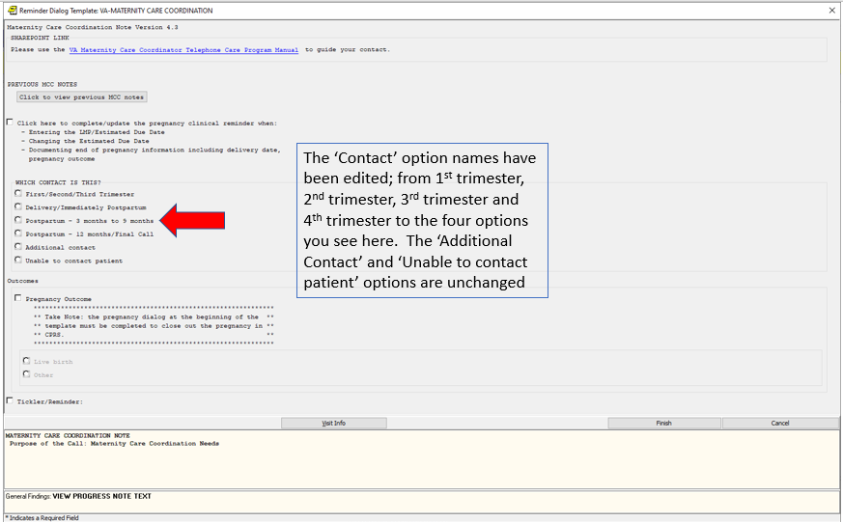
Contact Option

Slide 3
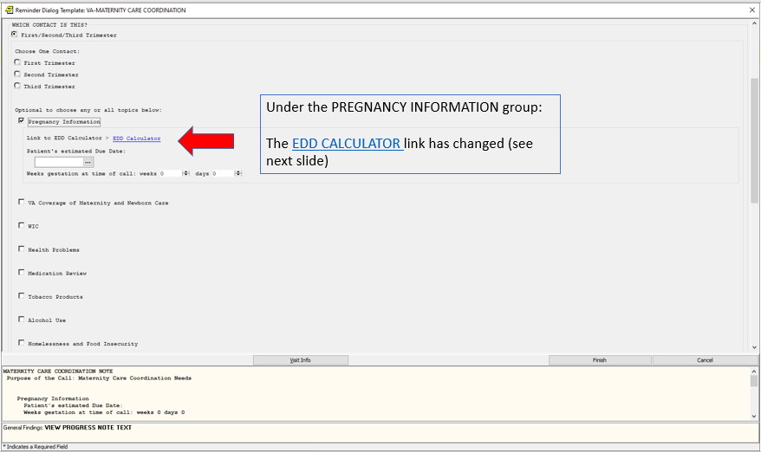
EDD Calculator

Slide 4
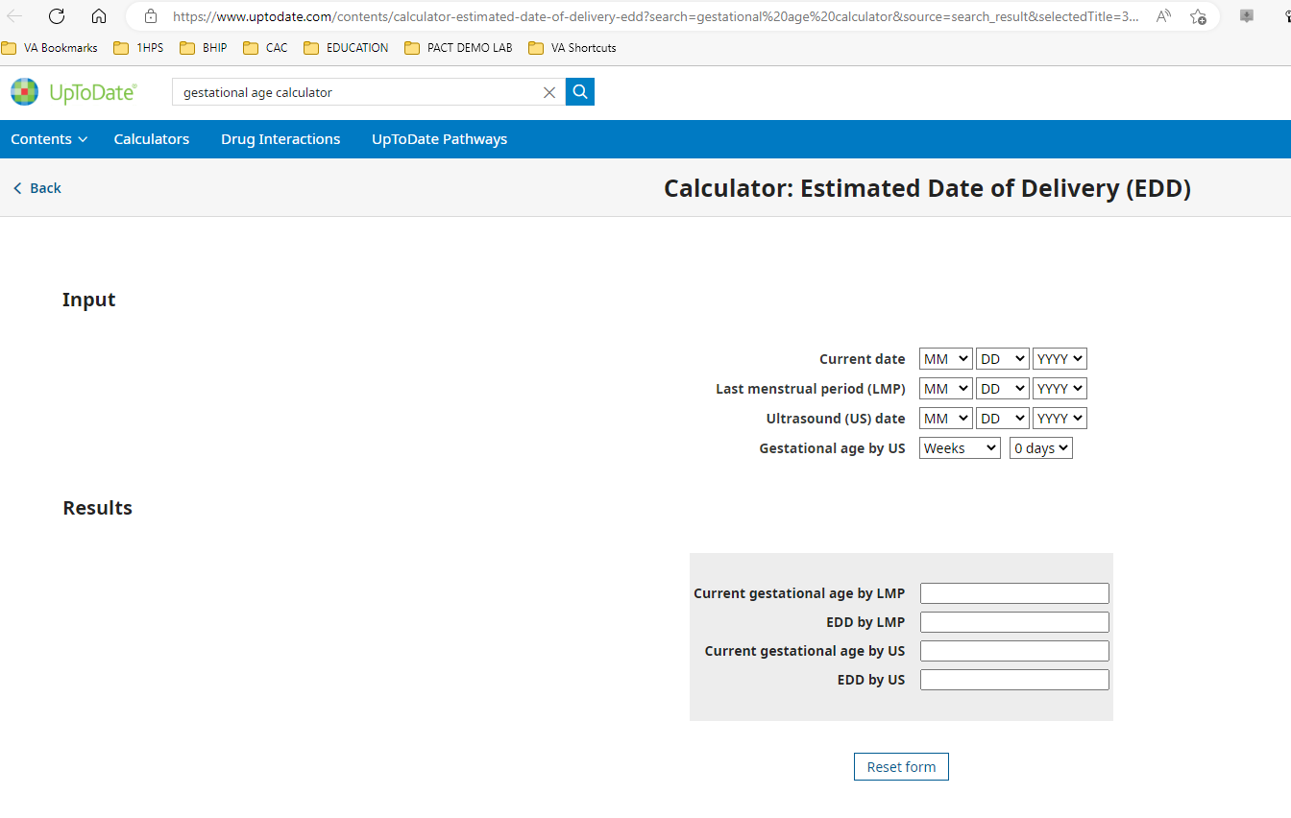
UpToDate EDD Calculator

Slide 5
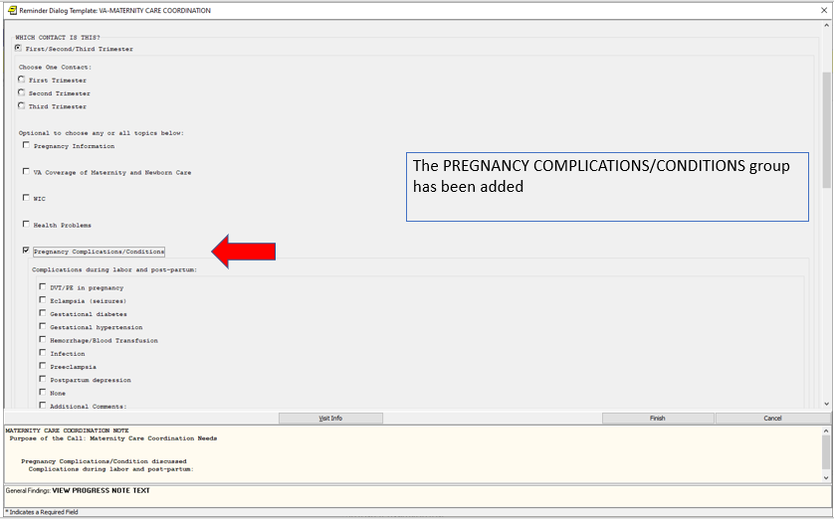
Pregnancy Complications Group

Slide 6
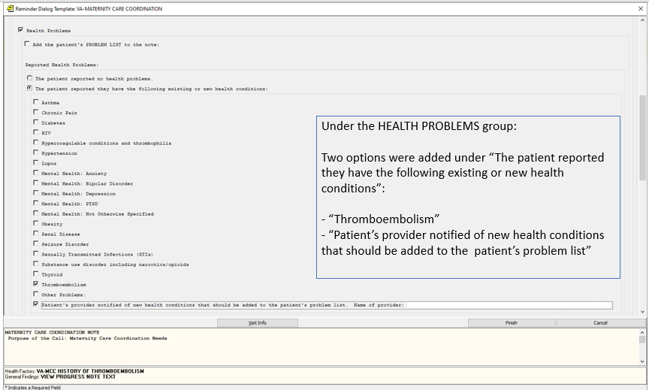
Health Problems Group

Slide 7
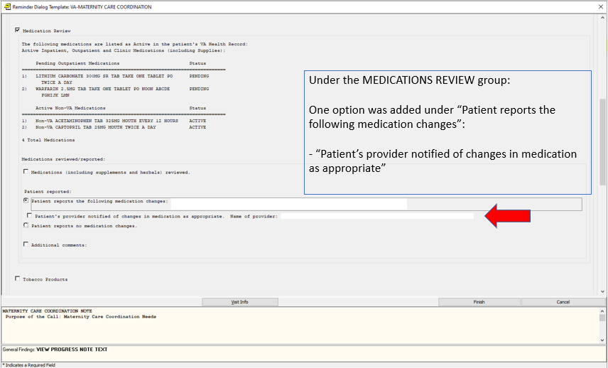
Medications Review Group

Slide 8
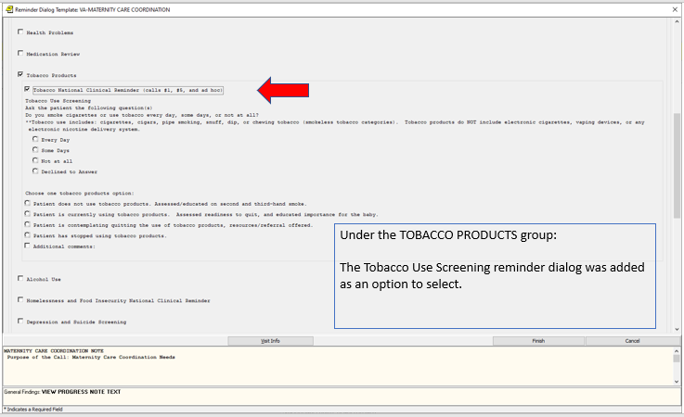
Tobacco Products Group

Slide 9
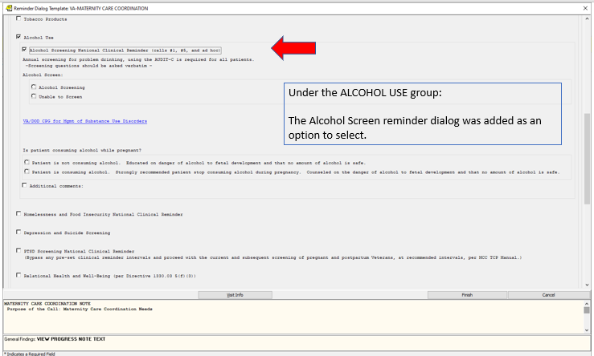
Alcohol Use Group

Slide 10
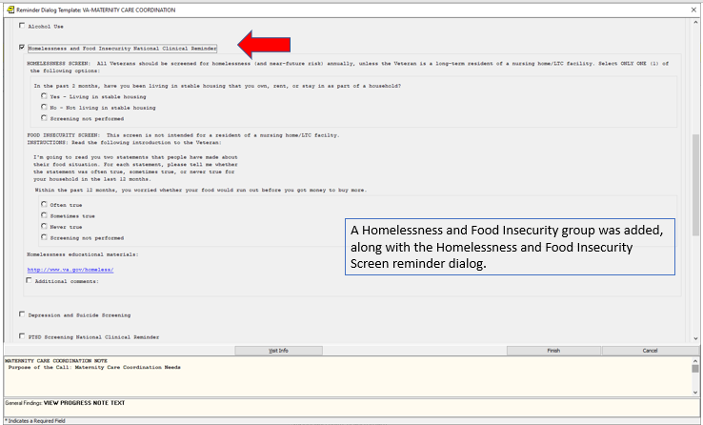
Homelessness and Food Insecrity Group

Slide 11
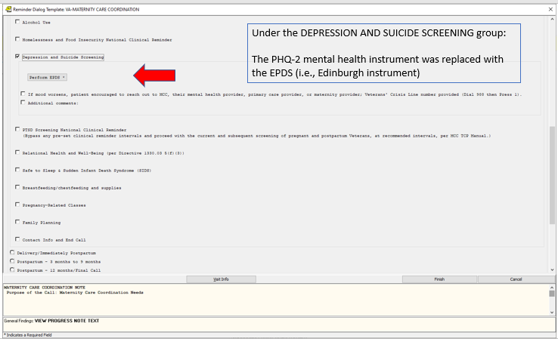
Depression and Suicide Group

Slide 12
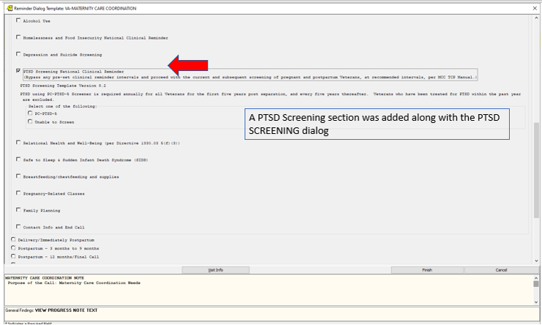
PTSD Group

Slide 13
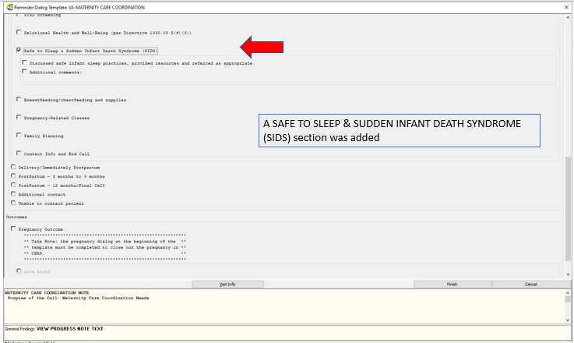
Safe Sleep and Sudden Infant Death Group

Slide 14
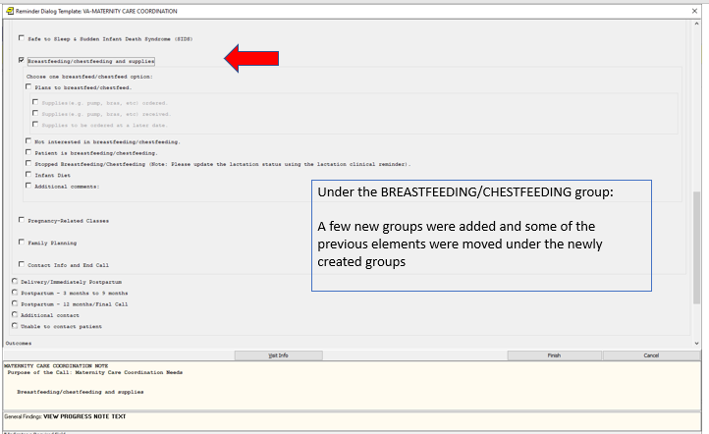
Breast Feeding / Chest Feeding Group

Slide 15
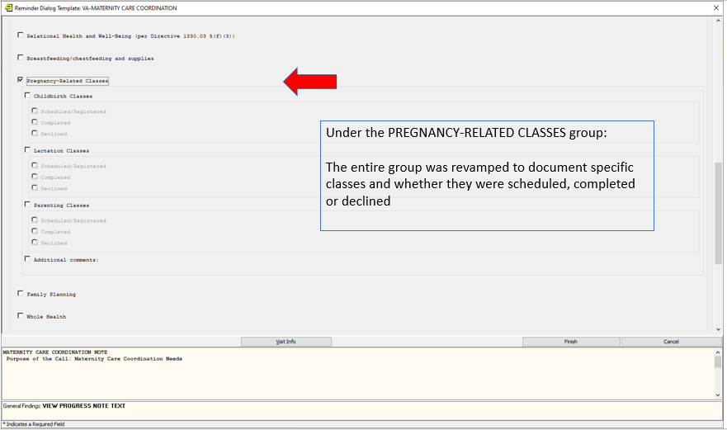
Pregnancy Related Classes Group

Slide 16
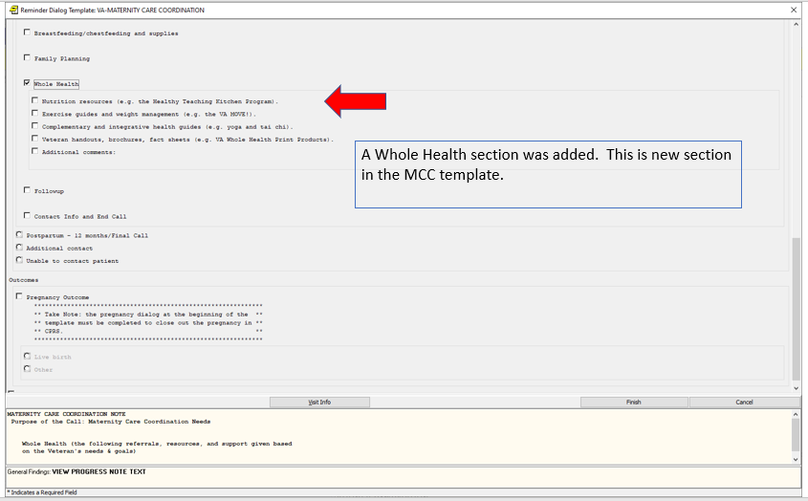
Whole Health Section was added

Slide 17
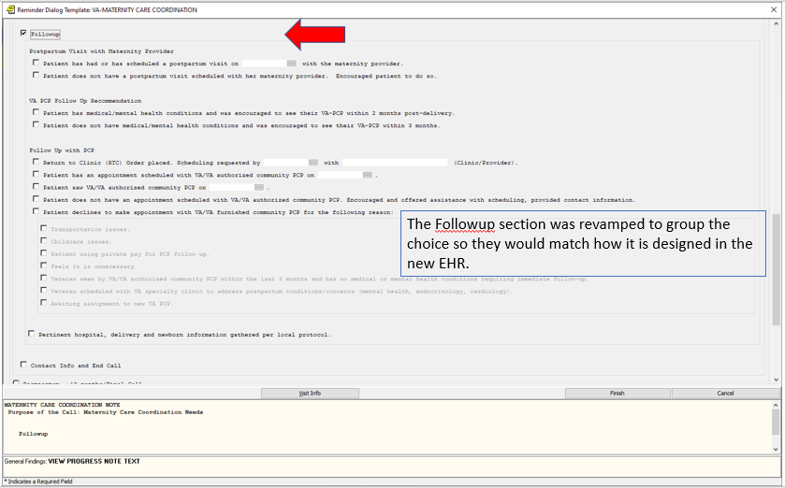
Followup Section Added

Slide 18
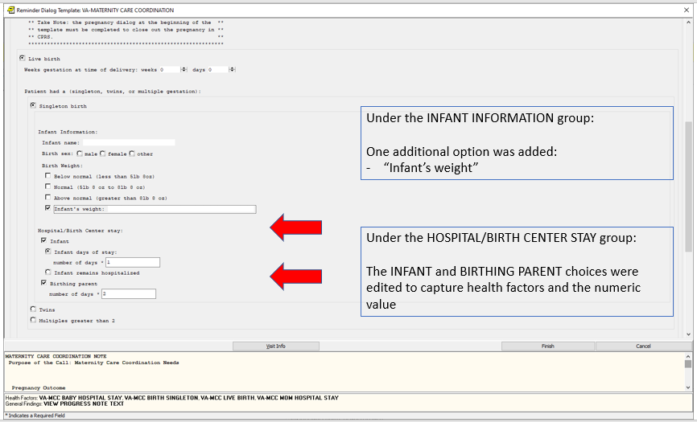
Infant Information and Hospital Birth Center Groups

Slide 19
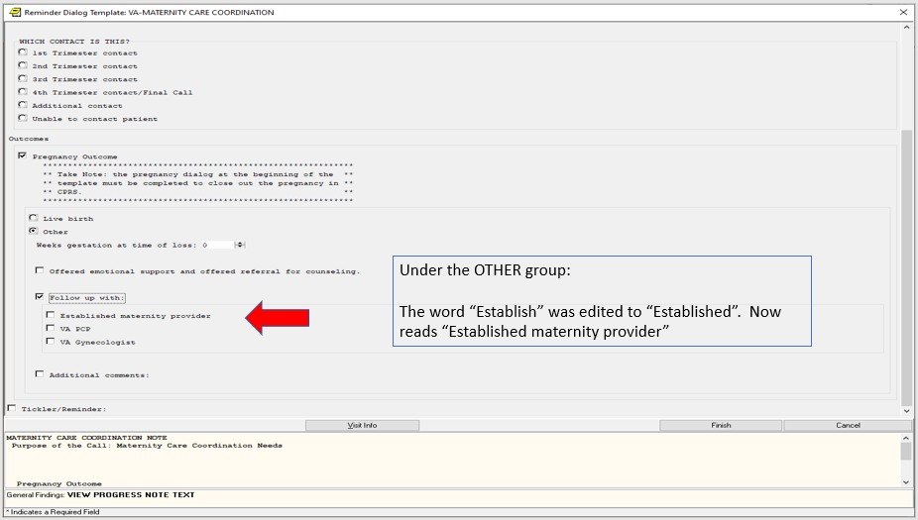
Under Outcomes, Other Group was edited

Slide 20
Updates to Pregnancy/Intentions/Contraception Reminder Dialog

Slide 21
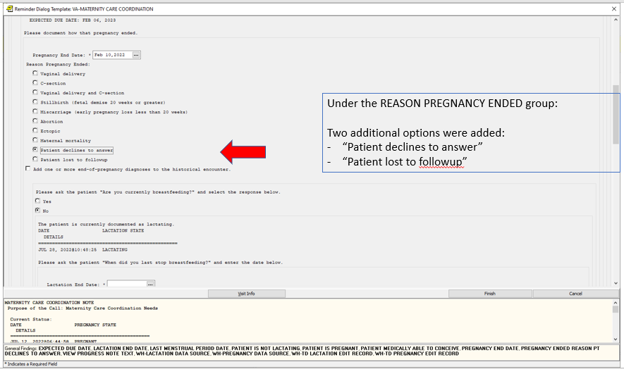
Reason Pregnancy Ended Group Edits

Slide 22
Update to Lactation Status Reminder Dialog

Slide 23
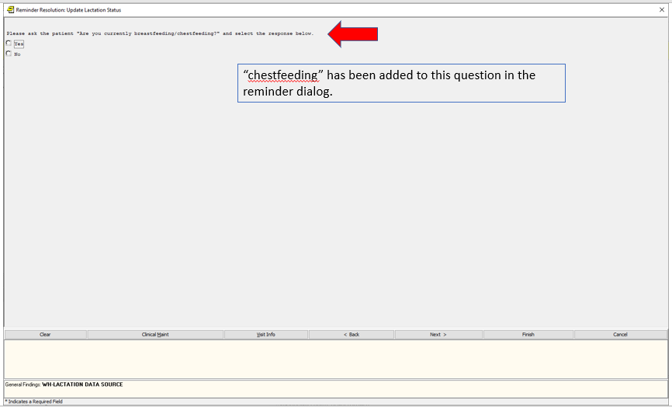
Lactation Reminder Dialog Edit

